Slide 1
Simulating Fraud Detection for a Selfcheck out store Zhi Zheng Victor Miranda Alex Hughes
Optimization and Simulation
(SP 2024_ESI5315.01 I&T)

Slide 2
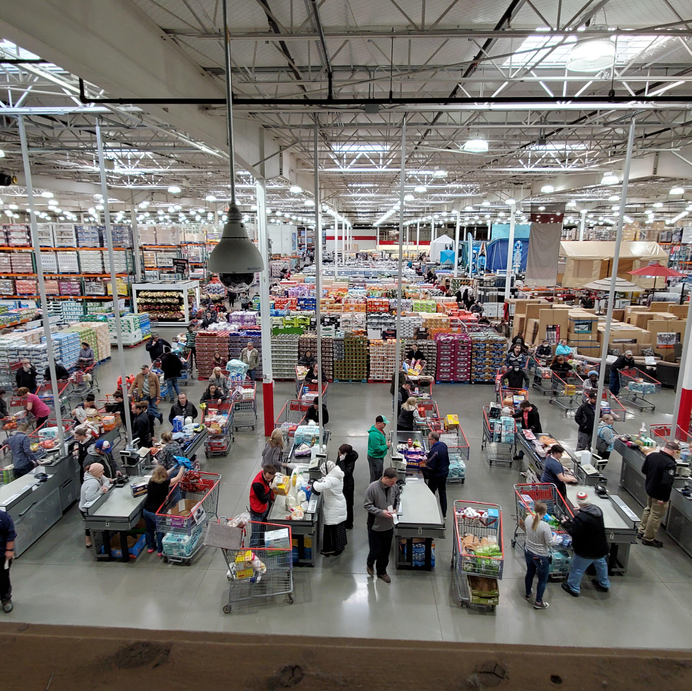
Introduction
Many stores use a self checkout system for labor savings, convince for customers, more available lines etc.…
While self checkout has many advantages it has also led to a rise in fraud and theft.
Self Check out has increased downtime due dealing with the fraud issues
Companies with self check out have a loss of about 4% which is double normal checkouts (1)
The photo to the right shows the typical layout of a Costco with side-by-side self check lanes
In this system customers enter the store, line in up in one of the self check lanes and then exit the store, there is a clerk standing nearby to help with issues as they arise.
1 https://www.cnn.com/2023/11/13/business/self-checkout-stores-shopping
Img src: https://i.redd.it/1vdqdiyaj3o41.jpg

Slide 3
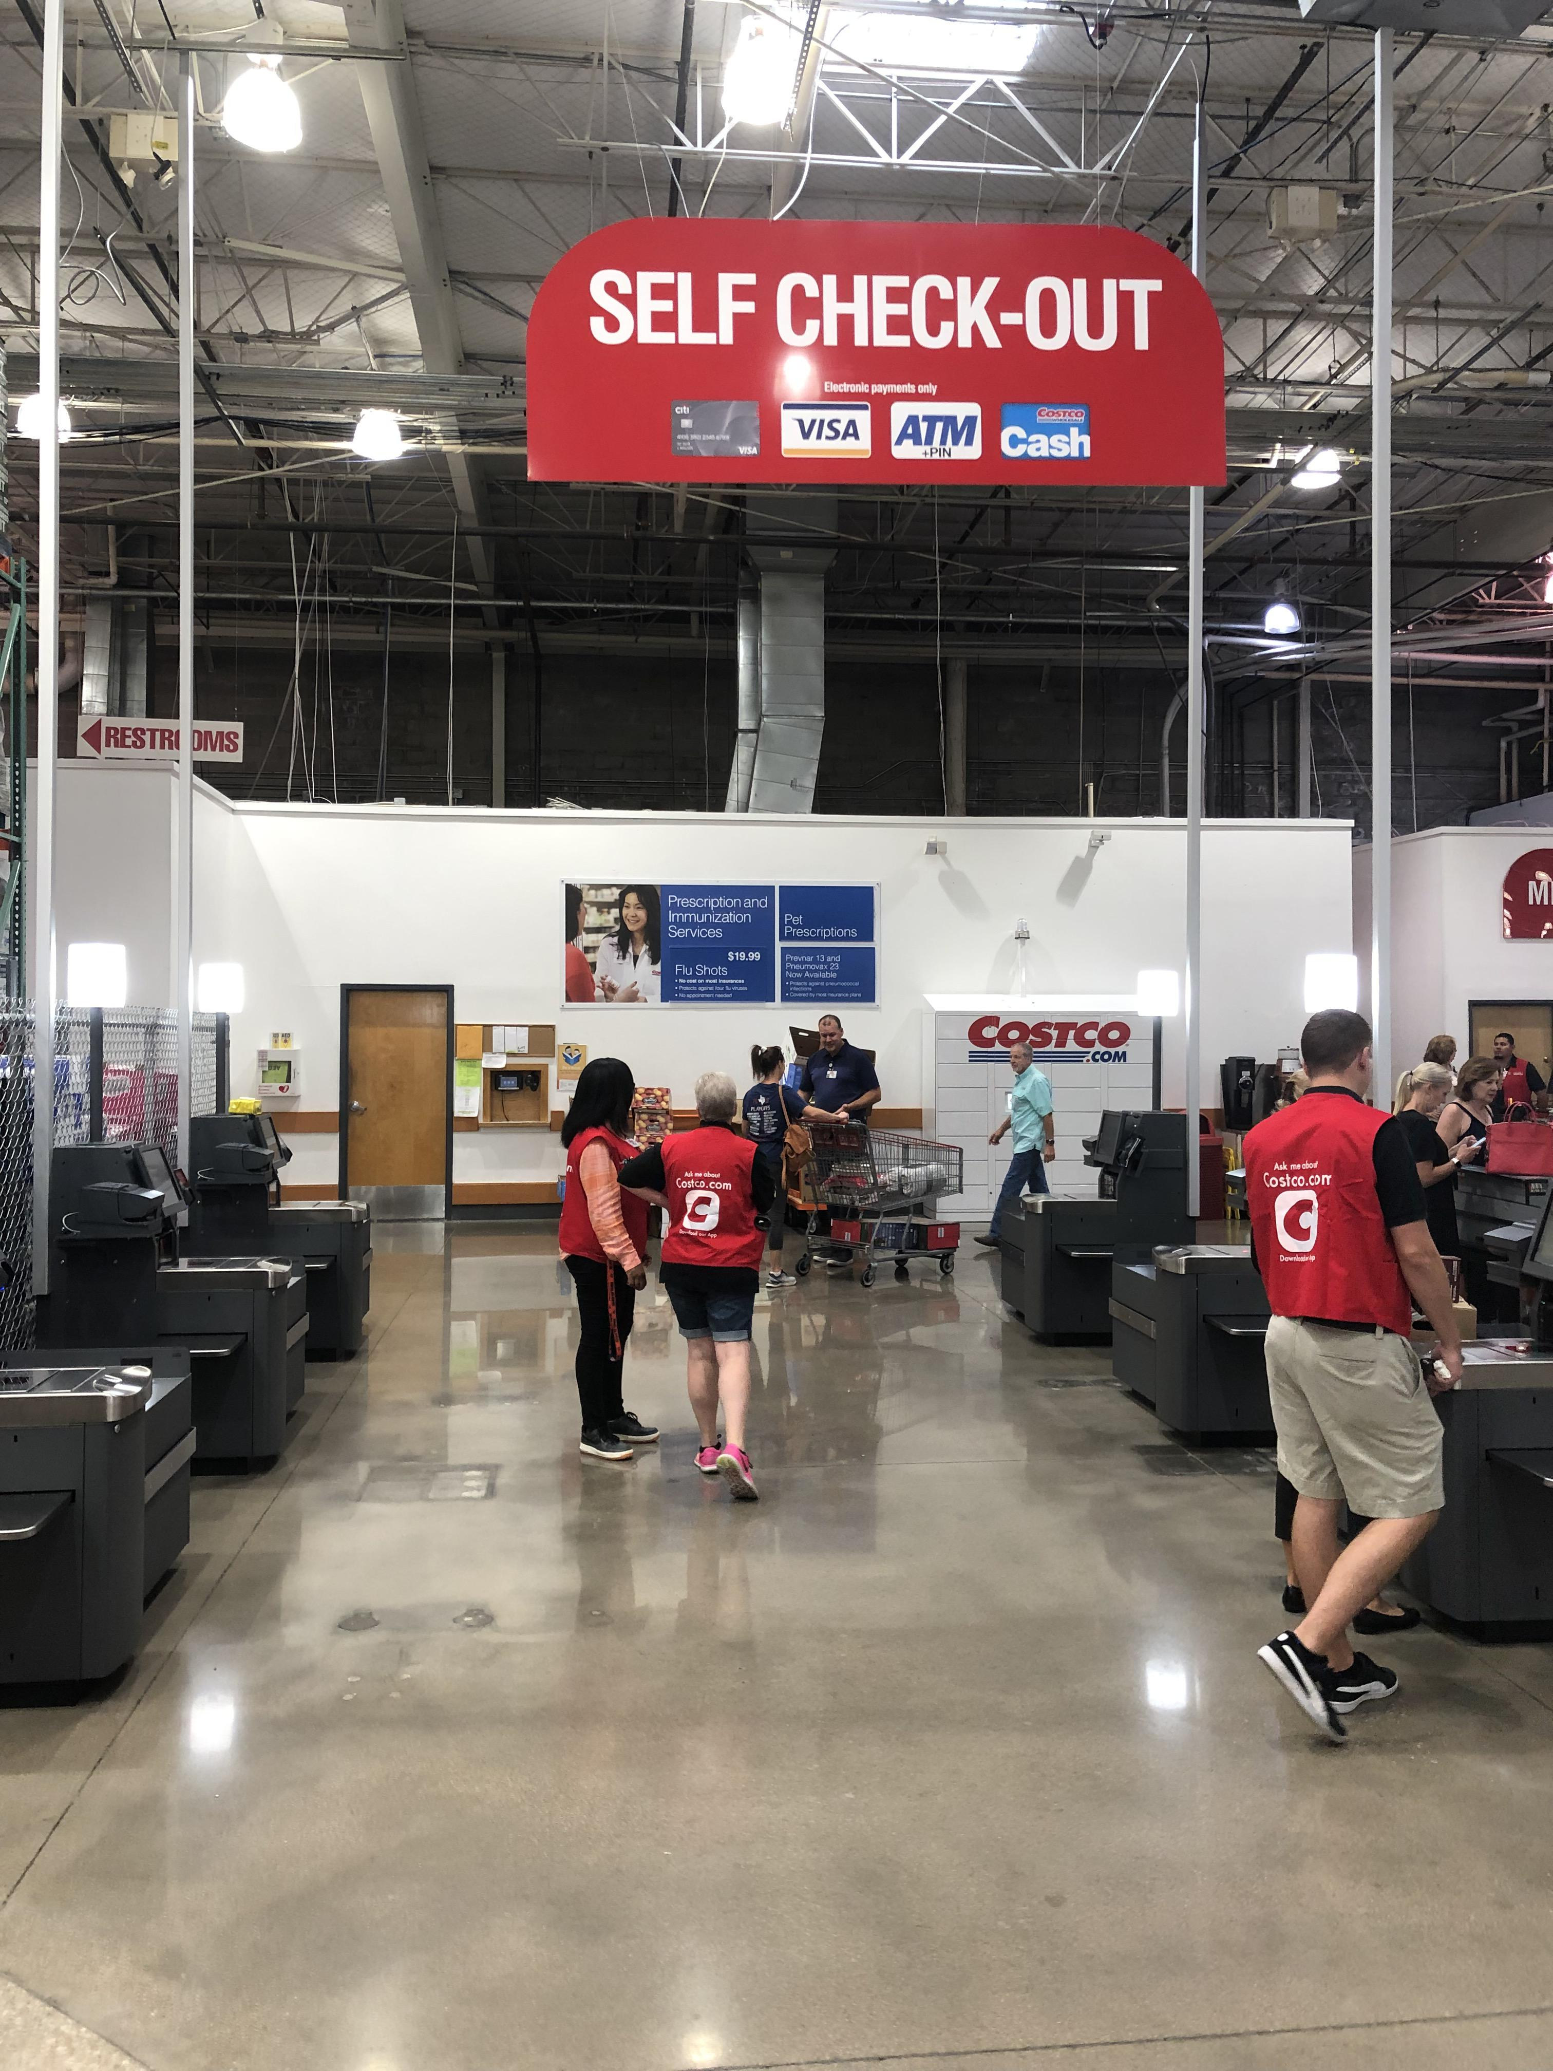
Problem & Objectives
Problem:
How is downtime from fraud effecting shoppers and throughput in a Costco like store.
Our simulation is set up like the Costco self check out with a que of shoppers, 6 self check out lanes and a clerk to help resolve issues.
Objections:
Simulation of shoppers going through the self checkout lanes.
Simulation of downtime from fraud to see how downtime from the fraud affects the flow and efficiency of shoppers using self check
Get an understanding of losses due to downtime of self check
Make suggestions to improve the model and throughput of customers
Img src: https://www.mashed.com/img/gallery/why-most-costco-locations-dont-have-self-checkout-stations-according-to-reddit/l-intro-1644394844.jpg

Slide 4
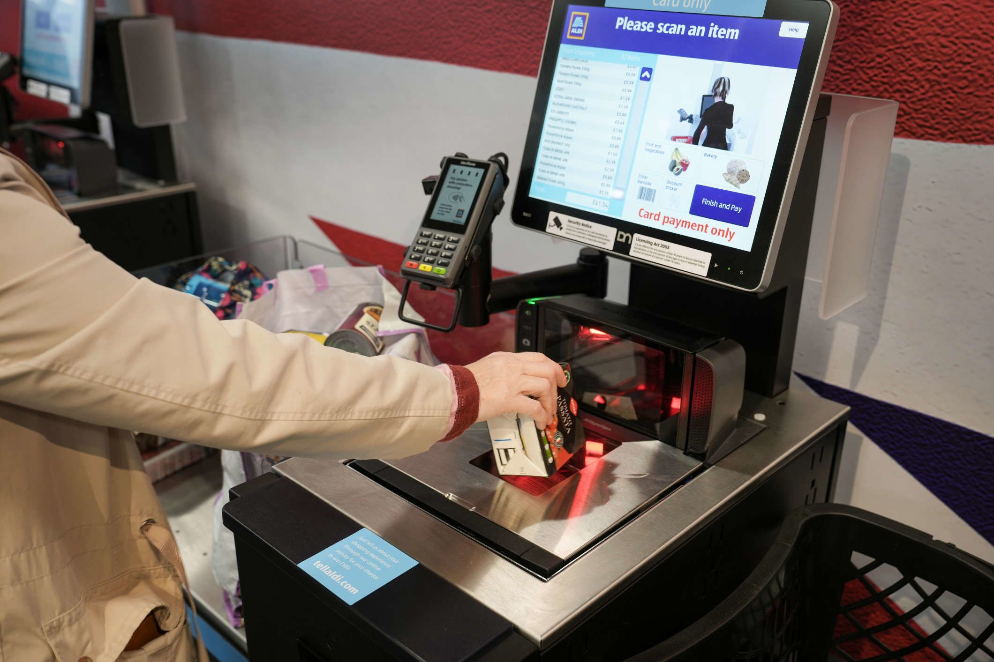
Data and Metrics Used
Dataset used:
Fraud Detection at self checkout
Found at https://www.kaggle.com/datasets/oscarm524/fraud-detection-in-grocery-shopping-transactions?select=test.csv
From dataset: fraud mean 0.0553486, integrated into our downtime
Other Data and metrics used:
Worker accounts put number of shoppers at around 200-500 in a day depending on location, for simplicity we chose 200-300 people per day (2) .
Shoppers average 4 minutes at the self check out (3)
We made a reasonable guess as 10 minutes of downtime per fraud detection this can easily be adjusted
We used 10.5 hours for each weekday
Img src: https://media.cnn.com/api/v1/images/stellar/prod/231114163305-self-checkout.jpg?c=original
References:
2:_https://www.reddit.com/r/Costco/comments/7nwtje/how_many_people_shop_at_your_costco/
3:_https://www.magestore.com/features/self-checkout-systems-in-retail

Slide 5

Enhancing Efficiency at Self-Checkouts
Purpose: Introduce the simulation's main objective to minimize human resource requirements at self-checkout systems while ensuring optimal operation.
Specific Goals: Reduce the overall number of staff needed without compromising service quality.
Automate processes where possible to reduce dependency on human intervention.
Criteria for Success: Reduction in human resources used per shift.

Slide 6
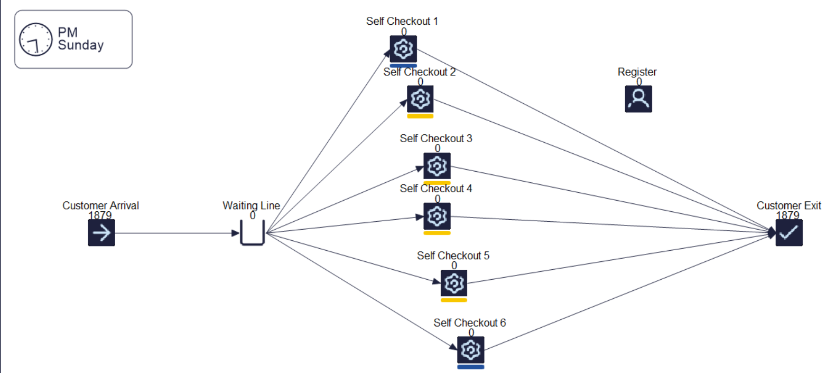
SIMUL8 Model Layout for Self-Checkout Optimization

Slide 7

Parameters Of The Simul8 Model
Daily Units of Customer: 200 People each Days
Average of Fraud occurrence: 5.5%
Average Customer Checkout Pace: 4 Minutes
Average MTTF: 58.62 Minutes
Average MTTR: 8 Minutes

Slide 8

Finding of the Model
Based on the current model result, just having a single worker can handle six self-checkout station optimized to handle fraud.
Each station have average of .32-.36 work item activity.
With 78% worker utilization.
Average 18.62 work item completion.

Slide 9
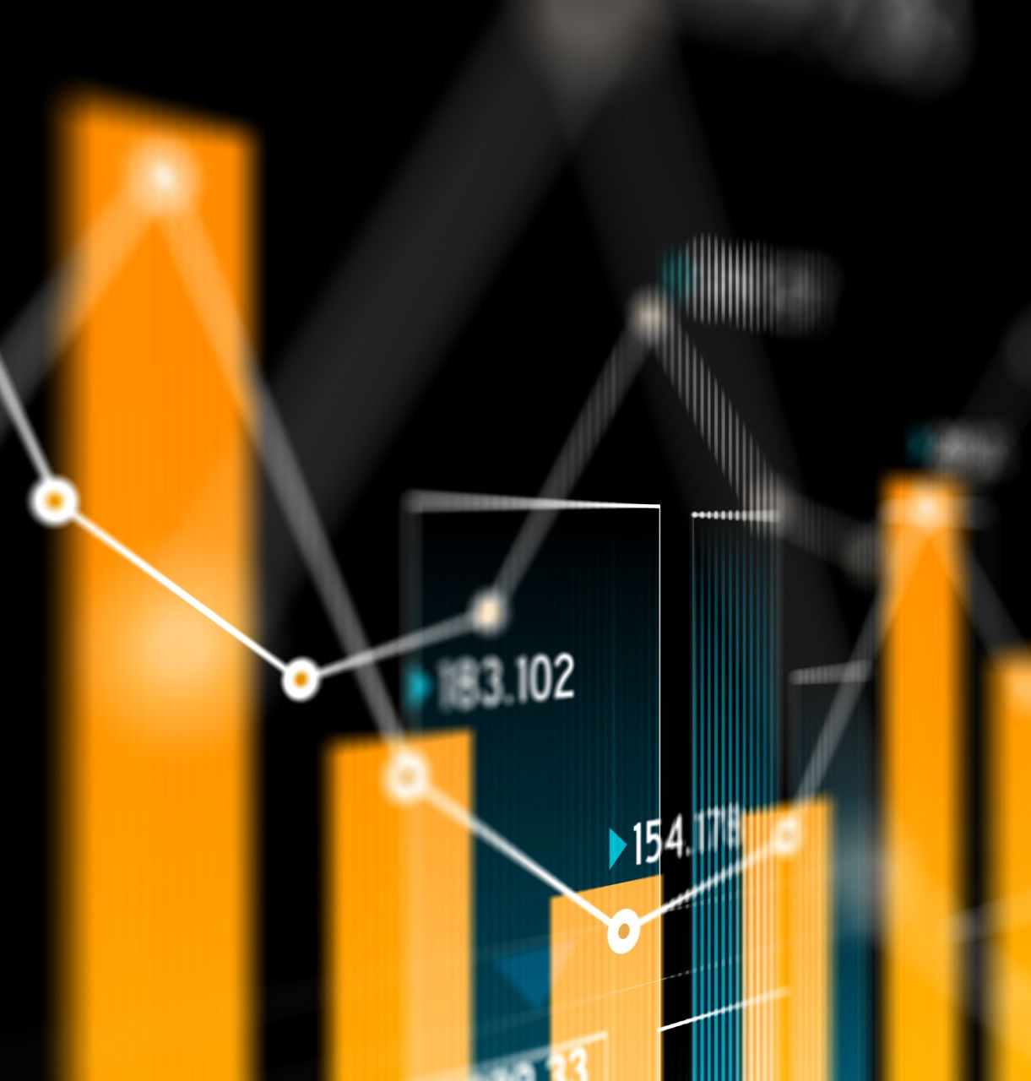
Recommendations Improving The Model
Recommendations:
Adding shifts to the resources
Optimal scheduling models to align staff with customer demand curves.
Expected Benefits:
Long-term reductions in labor costs.
Improved customer experience due to streamlined operations.

